Slide 2

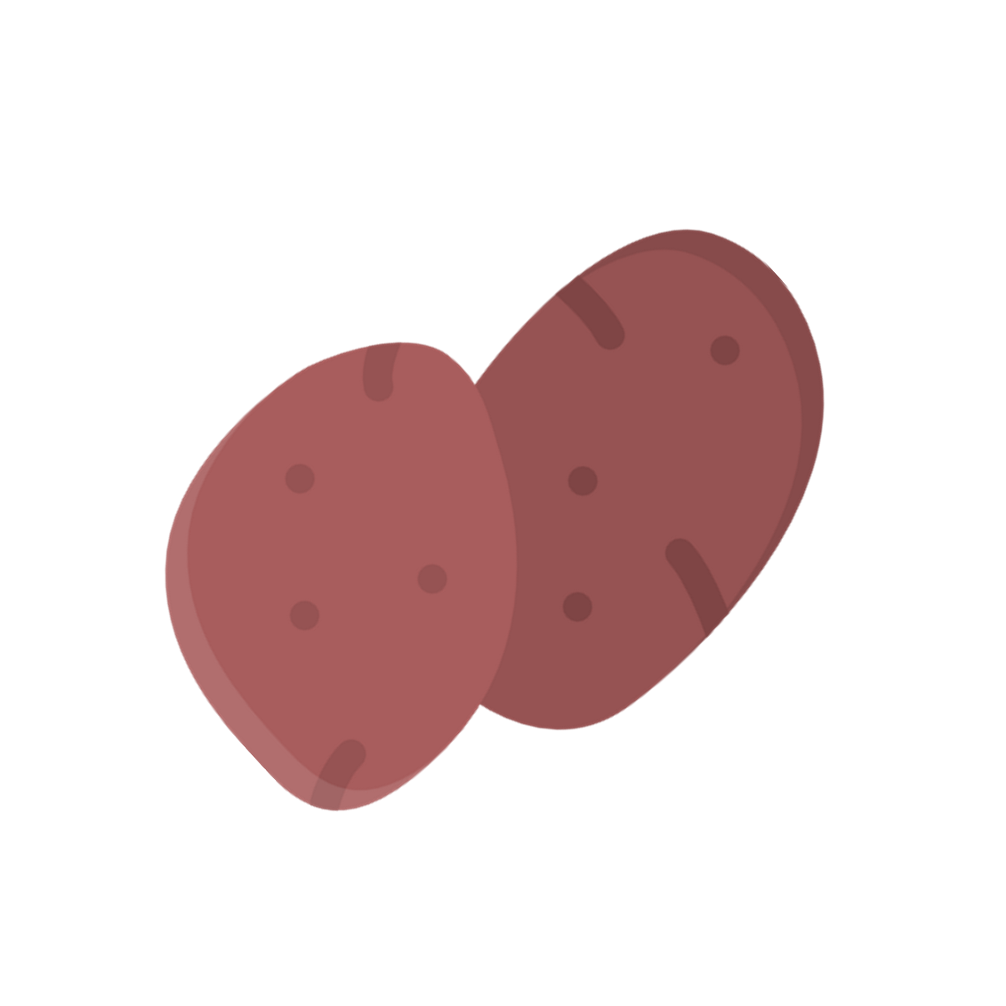



Slide 3



Slide 4
Purpose

Slide 5
Agenda
Purpose
Company Information
Product Introduction
Benefits of the Product

Slide 6
Company Information
Company Information
Product Introduction
Benefits of the Product
Agenda
Purpose

Slide 7

Agenda
Company Information
Company Information
Product Introduction
Benefits of the Product
Call to Action

Slide 8
Agenda
Mission
Vision
Objectives
Company Information

Slide 9
Agenda
Mission
Vision
Objectives
Company Information

Slide 10
Product
Introduction
About The Team
Mission
Vision
Objectives

Slide 11
Product
Introduction
About The Team
Mission
Vision
Objectives

Slide 12
About The Team
Product
Introduction
Mission
Vision
Objectives

Slide 13

Kamote Fries Delights
About The Team
- Caramelized
Mission
Vision
Objectives

Slide 14
Kamote Fries Delights
- Caramelized
- Classic
Mission
Vision
Objectives

Slide 15
Kamote Fries Delights
- Classic
Krunchy Kamote Fries Delight (Choco)
Limited Edition

Slide 16
Kamote Doughnut Delights
Kamote Fries Delights
Limited Edition
- Classic
Krunchy Kamote Fries Delight (Choco)

Slide 17
Kamote Doughnut Delights
Limited Edition
Krunchy Kamote Fries Delight (Choco)
- Sugar Glazed
- Classic
Mission
Vision
Objectives

Slide 18
Kamote Doughnut Delights
- Classic
- Sugar Glazed
Kreamy Kamote Doughnut Delight (Ube or Mango)
Krunchy Kamote Fries Delight (Choco)
Limited Edition

Slide 19
Kamote Ice Candy Delights
Kamote Doughnut Delights
Kamote ice Candy Delights
Limited Edition
- Classic
- Sugar Glazed
- Caramelized
Kreamy Kamote Doughnut Delight (Ube or Mango)

Slide 20
Kamote Ice Candy Delights
Limited Edition
Kreamy Kamote Doughnut Delight (Ube or Mango)
- Mango Ube
- Ube
Mission
Vision
Objectives

Slide 21
Kamote Ice Candy Delights
- Ube
- Mango Ube
Kreamy Kamote Doughnut Delight (Ube or Mango)
Krunchy Kamote Fries Delight (Choco)
Limited Edition

Slide 22
Kamote Ice Candy Delights
- Ube
- Mango Ube
Kreamy Kamote Doughnut Delight (Ube or Mango)
Krunchy Kamote Fries Delight (Choco)
Limited Edition

Slide 23
Feedbacks and Testimonials
Kamote Ice Candy Delights
Why Should You Choose Chois’ Kamote Delights?
- Ube
- Mango Ube
Krunchy Kamote Fries Delight (Choco)
Limited Edition

Slide 24
“When I first tried Chois’ Kamote Delights, I was blown away by the incredible flavor and texture. The Kamote Fries were perfectly crispy on the outside and tender on the inside, while the Kamote Ice Candy melted in my mouth. It's such a refreshing change from ordinary snacks, and I can't get enough of them!“
- Christy
Feedbacks
and Testimonials
What Makes Our Product Unique?
- Ube
Limited Edition

Slide 25
"As a health-conscious individual, I've always struggled to find snacks that are both delicious and nutritious. That's when I discovered Kamote Delights. Not only are their treats incredibly tasty, but they're also made from high-quality Kamote, which is packed with vitamins and minerals. Now, I can enjoy guilt-free snacking!“
- Christian
Feedbacks
and Testimonials
What Makes Our Product Unique?
“When I first tried Chois’ Kamote Delights, I was blown away by the incredible flavor and texture. The Kamote Fries were perfectly crispy on the outside and tender on the inside, while the Kamote Ice Candy melted in my mouth. It's such a refreshing change from ordinary snacks, and I can't get enough of them!“
- Christy
- Ube
Limited Edition

Slide 26
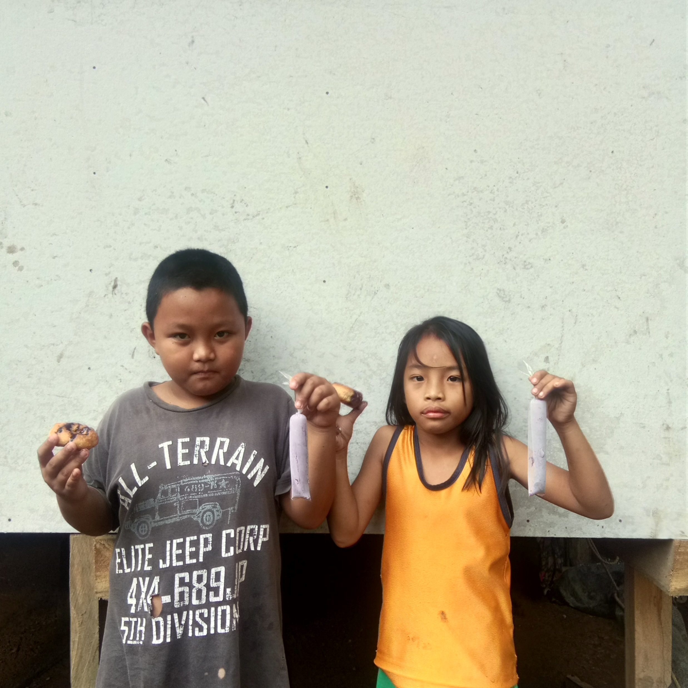
Feedbacks
and Testimonials
What Makes Our Product Unique?
"As a health-conscious individual, I've always struggled to find snacks that are both delicious and nutritious. That's when I discovered Kamote Delights. Not only are their treats incredibly tasty, but they're also made from high-quality Kamote, which is packed with vitamins and minerals. Now, I can enjoy guilt-free snacking!“
- Christian
- Ube
“When I first tried Chois’ Kamote Delights, I was blown away by the incredible flavor and texture. The Kamote Fries were perfectly crispy on the outside and tender on the inside, while the Kamote Ice Candy melted in my mouth. It's such a refreshing change from ordinary snacks, and I can't get enough of them!“
- Christy
Limited Edition

Slide 27
Thank You!
What Makes Our Product Unique?
Feedbacks
and Testimonials
"As a health-conscious individual, I've always struggled to find snacks that are both delicious and nutritious. That's when I discovered Kamote Delights. Not only are their treats incredibly tasty, but they're also made from high-quality Kamote, which is packed with vitamins and minerals. Now, I can enjoy guilt-free snacking!“
- Christian
- Ube
“When I first tried Chois’ Kamote Delights, I was blown away by the incredible flavor and texture. The Kamote Fries were perfectly crispy on the outside and tender on the inside, while the Kamote Ice Candy melted in my mouth. It's such a refreshing change from ordinary snacks, and I can't get enough of them!“
- Christy
Limited Edition

Slide 28
Questions
What Makes Our Product Unique?
"As a health-conscious individual, I've always struggled to find snacks that are both delicious and nutritious. That's when I discovered Kamote Delights. Not only are their treats incredibly tasty, but they're also made from high-quality Kamote, which is packed with vitamins and minerals. Now, I can enjoy guilt-free snacking!“
- Christian
Thank You!
“When I first tried Chois’ Kamote Delights, I was blown away by the incredible flavor and texture. The Kamote Fries were perfectly crispy on the outside and tender on the inside, while the Kamote Ice Candy melted in my mouth. It's such a refreshing change from ordinary snacks, and I can't get enough of them!“
- Christy
Limited Edition

Slide 29
What Makes Our Product Unique?
"As a health-conscious individual, I've always struggled to find snacks that are both delicious and nutritious. That's when I discovered Kamote Delights. Not only are their treats incredibly tasty, but they're also made from high-quality Kamote, which is packed with vitamins and minerals. Now, I can enjoy guilt-free snacking!“
- Christian
Questions
Thank You!
“When I first tried Chois’ Kamote Delights, I was blown away by the incredible flavor and texture. The Kamote Fries were perfectly crispy on the outside and tender on the inside, while the Kamote Ice Candy melted in my mouth. It's such a refreshing change from ordinary snacks, and I can't get enough of them!“
- Christy
Limited Edition

Slide 30
What Makes Our Product Unique?
"As a health-conscious individual, I've always struggled to find snacks that are both delicious and nutritious. That's when I discovered Kamote Delights. Not only are their treats incredibly tasty, but they're also made from high-quality Kamote, which is packed with vitamins and minerals. Now, I can enjoy guilt-free snacking!“
- Christian
Thank You!
“When I first tried Chois’ Kamote Delights, I was blown away by the incredible flavor and texture. The Kamote Fries were perfectly crispy on the outside and tender on the inside, while the Kamote Ice Candy melted in my mouth. It's such a refreshing change from ordinary snacks, and I can't get enough of them!“
- Christy
Questions
Limited Edition

